Slide 1
15-440 Distributed Systems
Distributed File Systems 2
Lecture 06, Sept 20th 2016

Slide 2
Logistical Updates
P0
  Due date: Midnight EST 9/22 (Thursday)
  NOTE: We will not accept P0 after Midnight EST 9/24
  Each late day constitutes a 10% penalty (max -20%)
  Attend office hours in case you are having trouble
Solutions for P0 discussed next Monday
  Recitation sections on Monday 9/26
  Learn about good solutions to P0
  May help to learn how to structure GO code (for P1)
  P1 Released!
For deadlines class page is most up to date
Notes:
Show of hands to see how many students can make the Tuesday time.

Slide 3
Review of Last Lecture
Distributed file systems functionality
Implementation mechanisms example
  Client side: VFS interception in kernel
  Communications: RPC
  Server side: service daemons
Design choices
  Topic 1: client-side caching
    NFS and AFS

Slide 4
Today's Lecture
DFS design comparisons continued
  Topic 2: file access consistency
    NFS, AFS
  Topic 3: name space construction
    Mount (NFS) vs. global name space (AFS)
  Topic 4: Security in distributed file systems
    Kerberos
Other types of DFS
  Coda – disconnected operation
  LBFS – weakly connected operation

Slide 5
Topic 2: File Access Consistency
In UNIX local file system, concurrent file reads and writes have “sequential” consistency semantics
  Each file read/write from user-level app is an atomic operation
    The kernel locks the file vnode
  Each file write is immediately visible to all file readers
Neither NFS nor AFS provides such concurrency control
  NFS: “sometime within 30 seconds”
  AFS: session semantics for consistency
Notes:
Question: What was the reason for this relaxed consiustency model for NFS and AFS?
- Performance
- Just hard to enforce Unix Semantics across distributed systems with independent failures.

Slide 6
Session Semantics in AFS v2
What it means:
  A file write is visible to processes on the same box immediately, but not visible to processes on other machines until the file is closed
  When a file is closed, changes are visible to new opens, but are not visible to “old” opens
  All other file operations are visible everywhere immediately
Implementation
  Dirty data are buffered at the client machine until file close, then flushed back to server, which leads the server to send “break callback” to other clients
Notes:
Chunk-based I/O
No real consistency guarantees
close() failures surprising to many Unix programs
...and to early Linux kernels!

Slide 7
AFS Write Policy
Writeback cache
  Opposite of NFS “every write is sacred”
  Store chunk back to server
    When cache overflows
    On last user close()
  ...or don't (if client machine crashes)
Is writeback crazy?
  Write conflicts “assumed rare”
  Who wants to see a half-written file?
Notes:
AFS also operates on a file granularity, so the last writer wins. Again, remember these assumptions come from the user model and workloads that AFS was designed for. Thought question: would this work for something like a collaborative document editing system like GoogleDocs?

Slide 8
Results for AFS
Lower server load than NFS
  More files cached on clients
  Callbacks: server not busy if files are read-only (common case)
But maybe slower: Access from local disk is much slower than from another machine’s memory over LAN
For both:
  Central server is bottleneck: all reads and writes hit it at least once;
  is a single point of failure.
  is costly to make them fast, beefy, and reliable servers.
Notes:
Question: Is access from local disk always slower than that over the N/W
When might that not be the case? Slow / WAN links ➔ but that’s not what AFS was designed in mind!
SSDs are really fast.

Slide 9
Topic 3: Name-Space Construction and Organization
NFS: per-client linkage
  Server: export /root/fs1/
  Client: mount server:/root/fs1 /fs1
AFS: global name space
  Name space is organized into Volumes
    Global directory /afs;
    /afs/cs.wisc.edu/vol1/…; /afs/cs.stanford.edu/vol1/…
  Each file is identified as fid = <vol_id, vnode #, unique identifier>
  All AFS servers keep a copy of “volume location database”, which is a table of vol_id→ server_ip mappings
Notes:
Vol_id identifies a vol of files stored on a single server
Vnode # provides and index into an array on the server; the array entry contains information about how to access the files
Uniquifier ensures that no fid-triplet is ever used more than once in the history of the file system; this allows vnode #’s to be reused

Slide 10
Implications on Location Transparency
NFS: no transparency
  If a directory is moved from one server to another, client must remount
AFS: transparency
  If a volume is moved from one server to another, only the volume location database on the servers needs to be updated

Slide 11
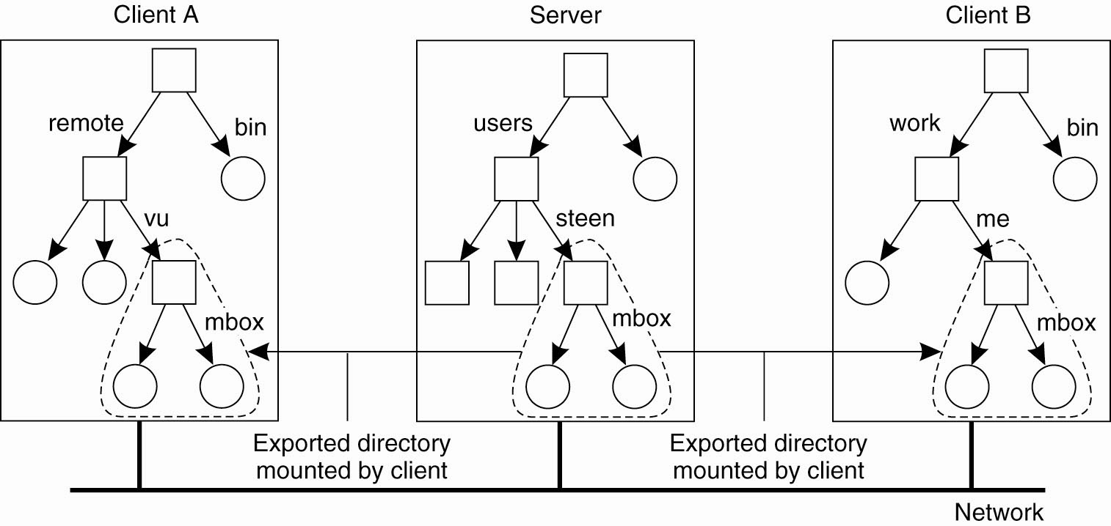
Naming in NFS (1)
Figure 11-11. Mounting (part of) a remote file system in NFS.
No naming transparency since both clients have the files (eg.mbox) stored in different hierarchcal namespaces.
Notes:
Note here that there is no naming transparency since both clients have the files (eg.mbox) stored in different hierarchcal namespaces.
Solution for this? Standardize some of the namespaces (e.g. /bin/ … /sbin/… /local/.... Or /mnt/… ) and maybe add symlinks to standard places like /home/<username>/ …

Slide 12
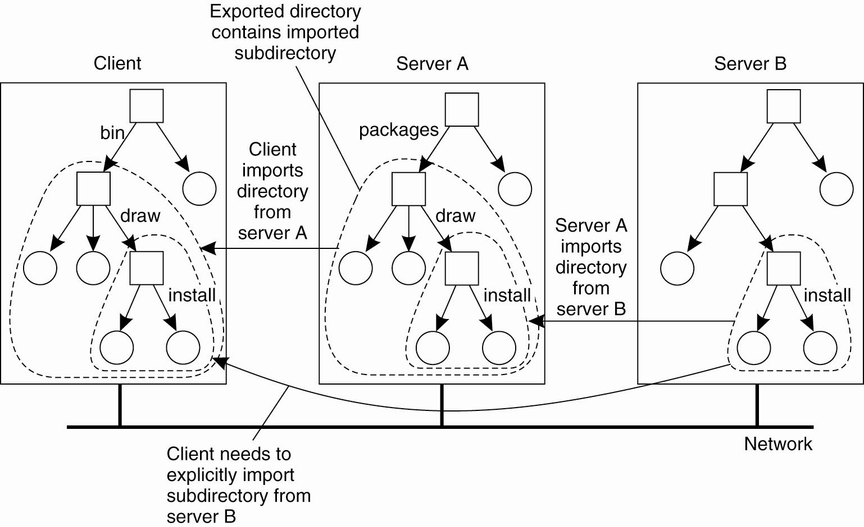
Naming in NFS (2)
Problem: Requires iterative name lookups and mounting filesystems
Solution? NFSv4 deals with this using automounting and other primitives
Notes:
Example of limitations in NFS where it does not do iterative name lookups. In this case, there will be multiple lookups needed since Server A maps part of the exported directory from Server B and in order to resolve /bin/draw/install both filesystems will have to be mounted (addressed in NFSv4 with automounting and other primitives).
Automounter is implemented naively may become a performance bottleneck, and hence NFS uses a clever solution using symlinks. ( /home/vu/mbox points to /tmp_home/vu which can be created by the automounter)

Slide 13
Implications on Location Transparency
NFS: no transparency
  If a directory is moved from one server to another, client must remount
AFS: transparency
  If a volume is moved from one server to another, only the volume location database on the servers needs to be updated

Slide 14
Topic 4: User Authentication and Access Control
User X logs onto workstation A, wants to access files on server B
  How does A tell B who X is?
  Should B believe A?
Choices made in NFS V2
  All servers and all client workstations share the same <uid, gid> name space → B send X’s <uid,gid> to A
    Problem: root access on any client workstation can lead to creation of users of arbitrary <uid, gid>
  Server believes client workstation unconditionally
    Problem: if any client workstation is broken into, the protection of data on the server is lost;
    <uid, gid> sent in clear-text over wire → request packets can be faked easily
Notes:
NFSv2 – really no security. With root access on a machine you can do anything.

Slide 15
User Authentication (cont’d)
How do we fix the problems in NFS v2
  Hack 1: root remapping → strange behavior
  Hack 2: UID remapping → no user mobility
  Real Solution: use a centralized Authentication/Authorization/Access-control (AAA) system
Notes:
Server accepts or rejects credentials
“root squashing”
map uid 0 to uid -1 unless client on special machine list
Kernel process on server “adopts” credentials
Sets user #, group vector based on RPC
Makes system call (e.g., read()) with those credentials

Slide 16
A Better AAA System: Kerberos
Basic idea: shared secrets
  User proves to KDC who he is; KDC generates shared secret between client and file server
KDC
ticket server
generates S
“Need to access fs”
K_{client}[S]
file server
K_{fs}[S]
encrypt S with
client’s key
client
S: specific to {client,fs} pair;
“short-term session-key”; expiration time (e.g. 8 hours)
Notes:
K_{client}[S] means encrypt S using client’s private key

Slide 17
Today's Lecture
DFS design comparisons continued
  Topic 2: file access consistency
    NFS, AFS
  Topic 3: name space construction
    Mount (NFS) vs. global name space (AFS)
  Topic 4: AAA in distributed file systems
    Kerberos
Other types of DFS
  Coda – disconnected operation
  LBFS – weakly connected operation

Slide 18
Background
We are back to 1990s.
Network is slow and not stable
Terminal → “powerful” client
  33MHz CPU, 16MB RAM, 100MB hard drive
Mobile Users appeared
  1st IBM Thinkpad in 1992
We can do work at client without network

Slide 19
CODA
Successor of the very successful Andrew File System (AFS)
AFS
  First DFS aimed at a campus-sized user community
  Key ideas include
    open-to-close consistency
    callbacks

Slide 20
Hardware Model
CODA and AFS assume that client workstations are personal computers controlled by their user/owner
  Fully autonomous
  Cannot be trusted
CODA allows owners of laptops to operate them in disconnected mode
  Opposite of ubiquitous connectivity

Slide 21
Accessibility
Must handle two types of failures
  Server failures:
    Data servers are replicated
  Communication failures and voluntary disconnections
    Coda uses optimistic replication and file hoarding

Slide 22
Design Rationale
Scalability
  Callback cache coherence (inherit from AFS)
  Whole file caching
  Fat clients. (security, integrity)
  Avoid system-wide rapid change
Portable workstations
  User’s assistance in cache management

Slide 23
Design Rationale –Replica Control
Pessimistic
  Disable all partitioned writes
  - Require a client to acquire control (lock) of a cached object prior to disconnection
Optimistic
  Assuming no others touching the file
  conflict detection
  + fact: low write-sharing in Unix
  + high availability: access anything in range

Slide 24
What about Consistency?
Pessimistic replication control protocols guarantee the consistency of replicated in the presence of any non-Byzantine failures
  Typically require a quorum of replicas to allow access to the replicated data
  Would not support disconnected mode
  We shall cover Byzantine Faults and Failures later.

Slide 25
Pessimistic Replica Control
Would require client to acquire exclusive (RW) or shared (R) control of cached objects before accessing them in disconnected mode:
  Acceptable solution for voluntary disconnections
  Does not work for involuntary disconnections
What if the laptop remains disconnected for a long time?

Slide 26
Leases
We could grant exclusive/shared control of the cached objects for a limited amount of time
Works very well in connected mode
  Reduces server workload
  Server can keep leases in volatile storage as long as their duration is shorter than boot time
Would only work for very short disconnection periods

Slide 27
Optimistic Replica Control (I)
Optimistic replica control allows access in every disconnected mode
  Tolerates temporary inconsistencies
  Promises to detect them later
  Provides much higher data availability

Slide 28
Optimistic Replica Control (II)
Defines an accessible universe: set of files that the user can access
  Accessible universe varies over time
At any time, user
  Will read from the latest file(s) in his accessible universe
  Will update all files in his accessible universe

Slide 29
Coda States
Hoarding
Emulating
Recovering
Hoarding:
Normal operation mode
Emulating:
Disconnected operation mode
Reintegrating:
Propagates changes and detects inconsistencies

Slide 30
Hoarding
Hoard useful data for disconnection
Balance the needs of connected and disconnected operation.
  Cache size is restricted
  Unpredictable disconnections
Uses user specified preferences + usage patterns to decide on files to keep in hoard

Slide 31
Prioritized algorithm
User defined hoard priority p: how important is a file to you?
Recent Usage q
Object priority = f(p,q)
Kick out the one with lowest priority
+ Fully tunable
  Everything can be customized
- Not tunable (?)
  No idea how to customize
Hoard walking algorithm function of Cache Size
  As disk grows, cache grows

Slide 32
Hoard Walking
Equilibrium – uncached obj < cached obj
  Why it may be broken? Cache size is limited.
Walking: restore equilibrium
  Reloading HDB (changed by others)
  Reevaluate priorities in HDB and cache
  Enhanced callback
Increase scalability, and availability
Decrease consistency
Notes:
AVSG: Available Volume Storage Group

Slide 33
Emulation
In emulation mode:
  Attempts to access files that are not in the client caches appear as failures to application
  All changes are written in a persistent log,
  the client modification log (CML)
  Coda removes from log all obsolete entries like those pertaining to files that have been deleted
Notes:
So, if you create a file and then delete it – that will be in the Log. However CODA will optimize and not send that.

Slide 34
Persistence
Coda keeps its cache and related data structures in non-volatile storage
All Venus metadata are updated through
atomic transactions
  Using a lightweight recoverable virtual memory (RVM) developed for Coda
  Simplifies Venus design

Slide 35
Reintegration
When workstation gets reconnected, Coda initiates a reintegration process
  Performed one volume at a time
  Venus ships replay log to all volumes
  Each volume performs a log replay algorithm
Only care about write/write confliction
  Conflict resolution succeeds?
    Yes. Free logs, keep going…
    No. Save logs to a tar. Ask for help
In practice:
  No Conflict at all! Why?
  Over 99% modification by the same person
  Two users modify the same obj within a day: <0.75%

Slide 36
Remember this slide?
We are back to 1990s.
Network is slow and not stable
Terminal → “powerful” client
  33MHz CPU, 16MB RAM, 100MB hard drive
Mobile Users appear
  1st IBM Thinkpad in 1992

Slide 37
What’s now?
We are in 2000s now.
Network is fast and reliable in LAN
“powerful” client → very powerful client
  2.4GHz CPU, 4GB RAM, 500GB hard drive
Mobile users everywhere
Do we still need support for disconnection?
  WAN and wireless is not very reliable, and is slow

Slide 38
Today's Lecture
DFS design comparisons continued
  Topic 2: file access consistency
    NFS, AFS
  Topic 3: name space construction
    Mount (NFS) vs. global name space (AFS)
  Topic 4: AAA in distributed file systems
    Kerberos
Other types of DFS
  Coda – disconnected operation
  LBFS – weakly connected operation

Slide 39
Low Bandwidth File System
Key Ideas
A network file systems for slow or wide-area networks
Exploits similarities between files or versions of the same file
  Avoids sending data that can be found in the server’s file system or the client’s cache
Also uses conventional compression and caching
Requires 90% less bandwidth than traditional network file systems

Slide 40
Working on slow networks
Make local copies
  Must worry about update conflicts
Use remote login
  Only for text-based applications
Use instead a LBFS
  Better than remote login
  Must deal with issues like auto-saves blocking the editor for the duration of transfer
Notes:
Why not rsync? It also does incremental deltas etc.
The authors list many reasons. One key one is that rsync deals only with the same filenames. Hence if you change filename etc it won’t work. Or if the same content is across multiple files with different names (autosaves, swap files, etc). The use of the chunking solution + content based rabin fingerprints + compression all lead to a huge reduction in bandwidth used.

Slide 41
LBFS design
LBFS server divides file it stores into chunks and indexes the chunks by hash value
Client similarly indexes its file cache
Exploits similarities between files
  LBFS never transfers chunks that the recipient already has
Notes:
Note: Talk about de-duplication that happens in modern cloud storage systems too (Dropbox)!
Question: will this still work if file/date is encrypted?

Slide 42
Indexing
Uses the SHA-1 algorithm for hashing
  It is collision resistant
Central challenge in indexing file chunks is keeping the index at a reasonable size while dealing with shifting offsets
  Indexing the hashes of fixed size data blocks
  Indexing the hashes of all overlapping blocks at all offsets
Notes:
Why are these two approaches of indexing file chunks better or worse? Why is shifting offsets a problem?

Slide 43
LBFS chunking solution
Considers only non-overlapping chunks
Sets chunk boundaries based on file contents rather than on position within a file
Examines every overlapping 48-byte region of file to select the boundary regions called breakpoints using Rabin fingerprints
  When low-order 13 bits of region’s fingerprint equals a chosen value, the region constitutes a breakpoint
Notes:
Polynomial representation of data in 48-byte region modulo an irreducible polynomial
Boundary regions have the 13 least significant bits of their fingerprint equal to an arbitrary predefined value
Assuming random data, expected chunk size is 2¹³ = 8K

Slide 44
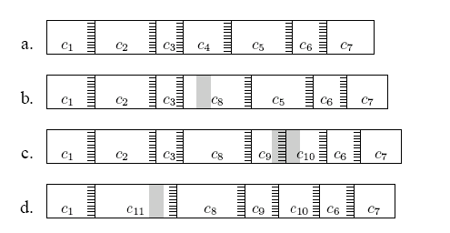
Effects of edits on file chunks
Chunks of file before/after edits
  Grey shading show edits
Stripes show regions with magic values that create chunk boundaries

Slide 45
More Indexing Issues
Pathological cases
  Very small chunks
    Sending hashes of chunks would consume as much bandwidth as just sending the file
  Very large chunks
    Cannot be sent in a single RPC
LBFS imposes minimum (2K) and maximum chunk (64K) sizes
Notes:
LBFS Chunk sizes: 2K - 64K

Slide 46
The Chunk Database
Indexes each chunk by the first 64 bits of its SHA-1 hash
To avoid synchronization problems, LBFS always recomputes the SHA-1 hash of any data chunk before using it
  Simplifies crash recovery
Recomputed SHA-1 values are also used to detect hash collisions in the database

Slide 47
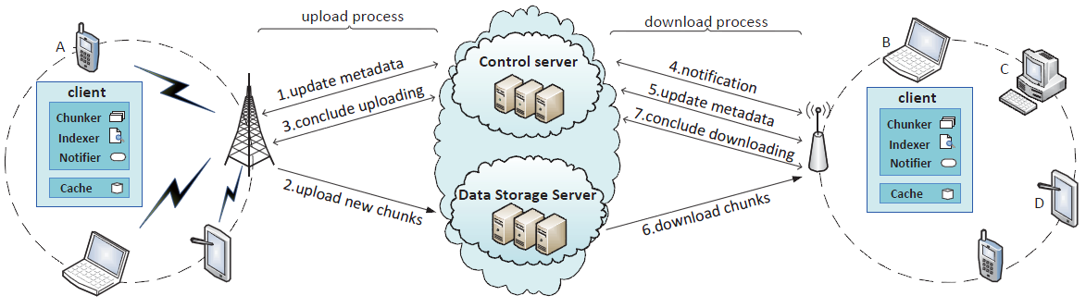
DFS in real life
Dropbox, Google Drive, OneDrive, BOX
100s of Millions of users, syncing petabytes (?)
  Basic function: Storing, sharing, synchronizing data between multiple devices, anytime, over any network
  General architecture (esp Dropbox)
Picture Credit: Yong Cui, QuickSync: Improving Synchronization Efficiency for Mobile Cloud Storage Services

Slide 48
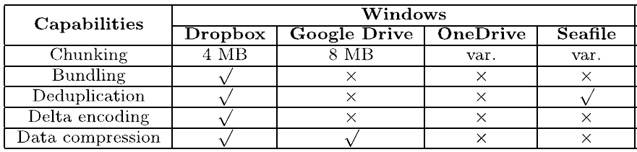
Features and Comparisons
Chunking: splitting a large file into multiple data units
Bundling: multiple small chunks as a single chunk
Deduplication: avoiding sending existing content in the cloud
Delta-encoding: transmit only the modified portion of a file
Question: Dropbox’s consistency model for conflicts?
Question: Why don’t we do data deduplication always?
Notes:
DROPBOX: eventually consistent, in case of conflicts it puts both files in the shared folder as ”Conflicted copies”
: Optimization: Lan Sync – so content from other devices around you can be synced faster
: Use model specific: They know which devices/users can actually conflict since they know the sharing
Dropbox: Why not do data dedup all the time?!?
PRIVACY!!! To do data dedup and optimizations like delta encoding Dropbox and other need to make sure that contents unencrypted.
If you encrypt data (e.g. crashplan, then some of these optimizations become really hard).

Slide 49
Key Lessons
Distributed filesystems almost always involve a tradeoff: consistency, performance, scalability.
We’ll see a related tradeoff, also involving consistency, in a while: the CAP tradeoff. Consistency, Availability, Partition-resilience.

Slide 50
More Key Lessons
Client-side caching is a fundamental technique to improve scalability and performance
  But raises important questions of cache consistency
Timeouts and callbacks are common methods for providing (some forms of) consistency.
AFS picked close-to-open consistency as a good balance of usability (the model seems intuitive to users), performance, etc.
  AFS authors argued that apps with highly concurrent, shared access, like databases, needed a different model

Slide 51
Key lessons for Coda
Puts scalability and availability before
data consistency
  Unlike NFS
Assumes that inconsistent updates are very infrequent => detect conflicts when reintegrating
Introduced disconnected operation mode by allowing cached data (weakly consistent), backed by a file hoarding database
Limitations?
  Detects only W/W conflicts, no R/W (lazy consistency)
  No client-client sharing possible

Slide 52
Key Lessons for LBFS
Under normal circumstances, LBFS consumes 90% less bandwidth than traditional file systems.
Makes transparent remote file access a viable and less frustrating alternative to running interactive programs on remote machines.
Key Ideas: Content based chunks definition, rabin fingerprints to deal with insertions/deletions, hashes to determine content changes, ...

